Slide 2
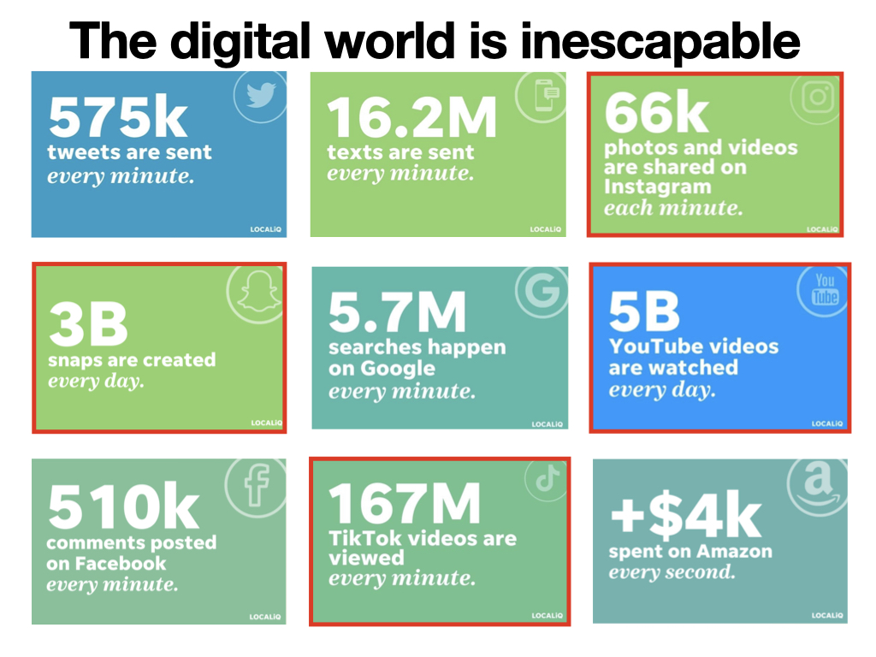
Notes:
Modern day internet use.
Is there anything here you find surprising?

Slide 3
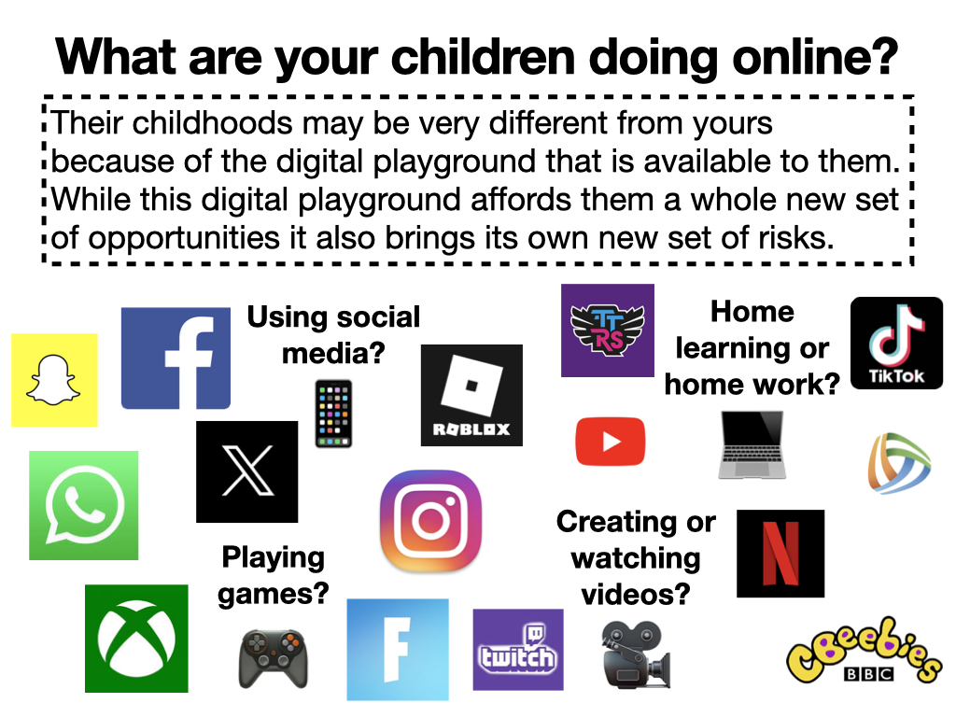
Notes:
Consider what your own playground would have looked like as a child and then compare it to our children's, which now includes a digital playground. This makes it hard for us as we are learning alongside the children rather than being able to draw on our own experiences as children.
There are primarily four categories of what children are doing online. Using social media, watching or creating videos, doing homework or other school work and playing online computer games. In the last four years, there has been a significant change in what children are doing online.
All of the apps/sites shown in this slide have their own threats to our children and whilst there are numerous benefits to most of these apps, children need to understand that any app or game that allows them to connect with other people, especially people they are unfamiliar with is potentially a threat.

Slide 4
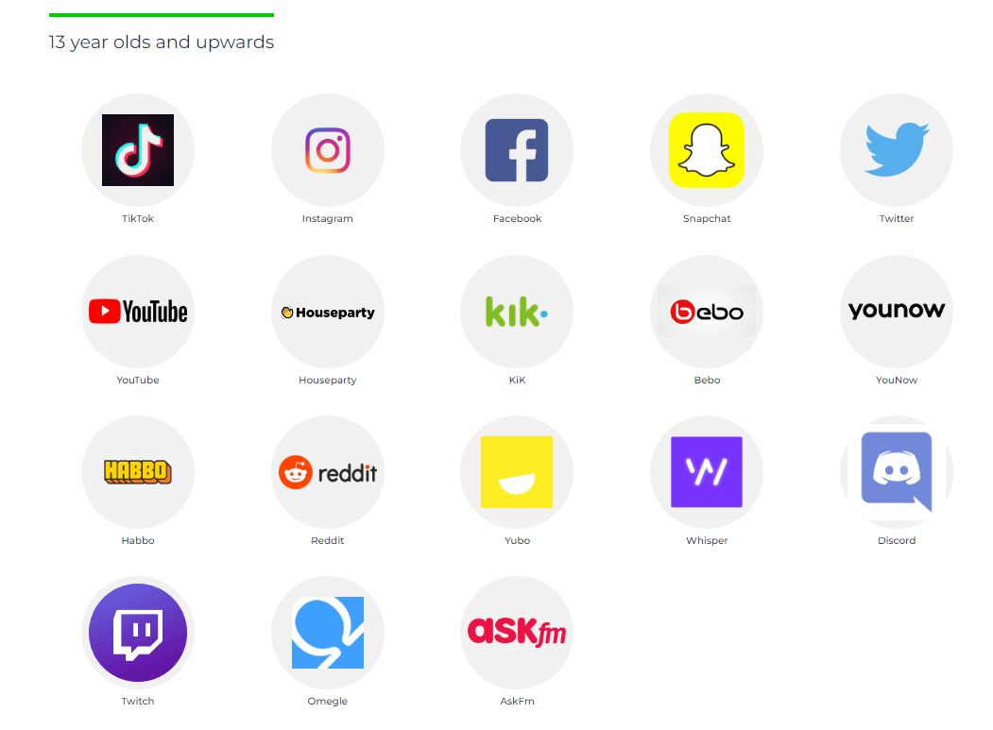
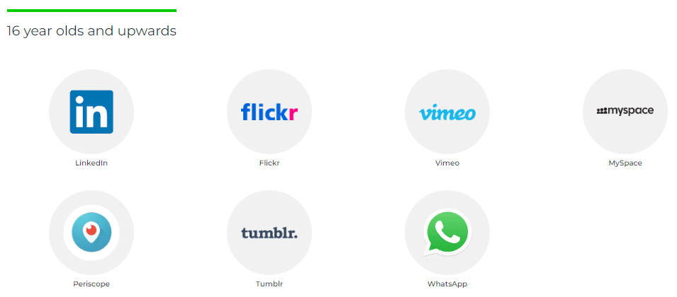
Minimum age on social media platforms
What age can my child start social networking? - Internet Matters
Notes:
Due to these threats, these are the recommended minimum ages for these social media platforms. However, we know many children of primary school age are using some of these regularly.
This is why we have to teach the children appropriate behaviours and skills for their online lives. If we can teach them how to behave safely online, the app or game they are using won’t matter as they will know how to behave regardless of their online situation.
That said, if you have a younger child or children that have not accessed any of these sites/ apps then get parameters and controls in place in the first instance rather than trying to wrestle back control. For example, this could be by only allowing certain apps and limiting time on a device. Set the boundaries early on to make your life easier. But please note, it is better to set boundaries late than not at all.

Slide 5
Online gaming
Online gaming has and continues to increase in popularity and the number of children accessing online games has grown year on year. Around 90% of children ages 3-17 play some form of video games. Boys are more likely to be playing online games.
The risks of online gaming are the same as in many other areas of children’s online lives. However, a child’s attention when playing online games is often focused on the game they are playing rather than protecting themselves. This may make children more vulnerable to people looking to harm or abuse them.
The majority of online games allow children to communicate with others, this can be via a headset or as a text chat feature within the game. Talk to your child about the importance of the content of these online conversations with others, which should never become personal or give anything away about their life.

Slide 6
Online gaming
Key Questions:
Are you aware of the content of the games your children are playing?
Are you aware of the other people they may be playing with online?
Are you aware of the content of the conversations your children are having with online friends?
Are you aware of parental controls that are available for the games your children are playing?
Do your children know what to do if they see/hear something inappropriate/upsetting?
Notes:
Opportunity to discuss experiences with other parents.
No shame or judgement – we all have something to learn from our own experiences.
Reflection on key takeaways going forward.

Slide 7
Social Media
Social Media continues to play a significant part in children’s lives. Girls are fractionally more likely to be using/posting to social media apps than boys.
The risks involved with social media usage not only includes communication from others but coming into contact with images, videos, influencers and other media that is inappropriate for their age range. This may include various forms of violence (real or simulated), bad language, pornography or unrealistic body/beauty standards.
When it comes to social media, the importance of setting a good example and being a positive role model should not be underestimated.

Slide 8
Social Media
Key Questions:
Are you aware of which apps your children are using to communicate?
Are you aware of the content that appears on these apps and how it is presented to your children?
Are you aware of the safety features/parental controls of each of these social media apps?
Notes:
Opportunity to discuss experiences with other parents.
No shame or judgement – we all have something to learn from our own experiences.
Reflection on key takeaways going forward.

Slide 9
Video sharing sites
Video sharing sites have also become increasingly popular over the last few years. By age 17, 98% of children watch online videos (92% for 3-4 year olds). While YouTube is the most popular and well known, there are numerous other sites that children can watch or post videos including TikTok and Twitch and sharing videos is now commonplace on almost all social media platforms.
Once again, the risks involved with video sharing sites include the content of videos that may be inappropriate for your child. However, for those children who may post or stream to a video sharing site, the risks of over sharing or unknowingly sharing personal information become very real.
A knowledge of these sites and what your children are doing on them is incredibly important.

Slide 10
Video sharing sites
Key Questions:
Which video sharing sites do your children use?
Who are your children’s favourite ‘YouTuber’ or influencer to watch and is their content appropriate?
Does your child post their own videos to video sharing sites? Who views their content?
Are there any parental/safety controls in place?
Notes:
Opportunity to discuss experiences with other parents.
No shame or judgement – we all have something to learn from our own experiences.
Reflection on key takeaways going forward.

Slide 11
Via Ofcom children’s media use and attitudes report
https://www.ofcom.org.uk/__data/assets/pdf_file/0027/255852/childrens-media-use-and-attitudes-report-2023.pdf

Slide 12
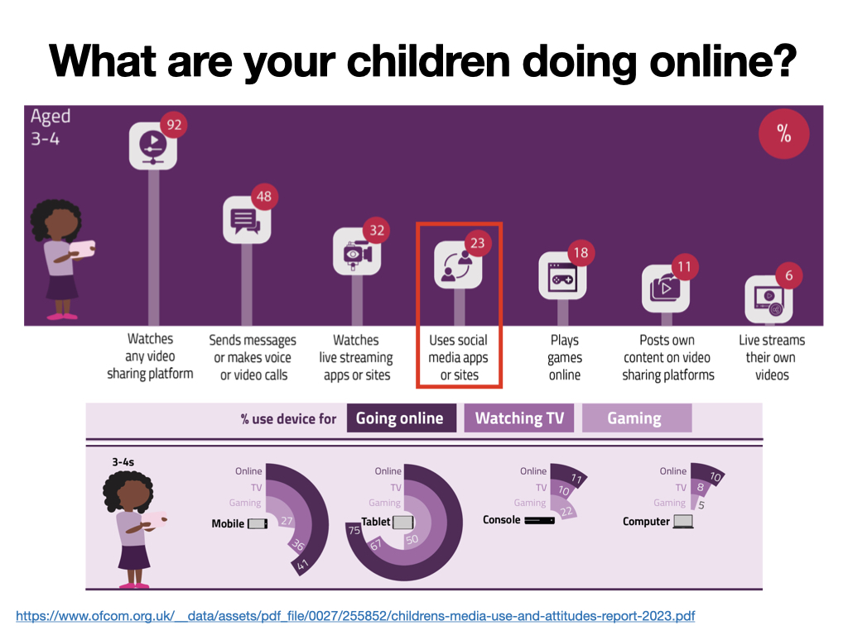
https://www.ofcom.org.uk/__data/assets/pdf_file/0027/255852/childrens-media-use-and-attitudes-report-2023.pdf
Notes:
3 - 4s - This data shows the early access children have to technology and the breadth of content that children consume. The data shows that YouTube is the most popular app for watching video but only half of the children that use YouTube use the kids version. What content might they be exposed to on the full site?
This is an ideal age to start setting boundaries and parameters.

Slide 13
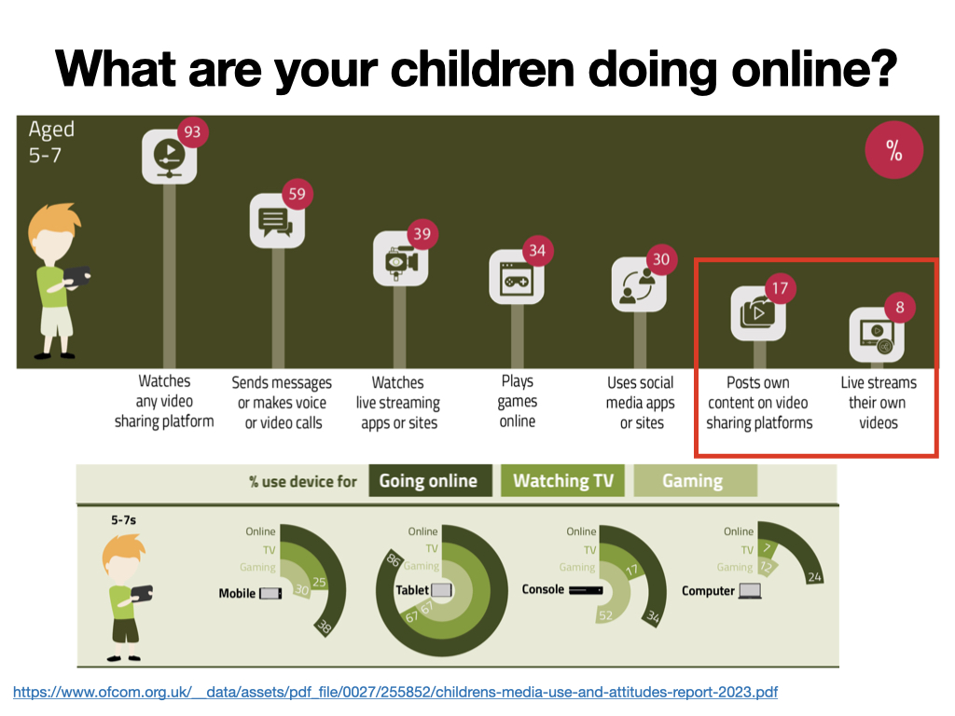
https://www.ofcom.org.uk/__data/assets/pdf_file/0027/255852/childrens-media-use-and-attitudes-report-2023.pdf
Notes:
5 - 7s - Some of the figures for this age range are staggering, for example 89% of children play computer games and of these 34% of children play games online. What are the risks?
At this age, children are becoming more independent and are supervised less when using devices. Are we aware of the content being consumed by the children or who they are talking to when playing games?
Further to the concerns regarding the scale of gaming in this age demographic, is the number of children using live streaming sites/apps. This could be to both consume content or create it. If they are consuming it how can we be sure the content is appropriate? If they are creating content, are you happy to allow them to post or to live stream, what information are they sharing online and are they prepared for negative comments/ criticism of the content they are sharing?

Slide 14
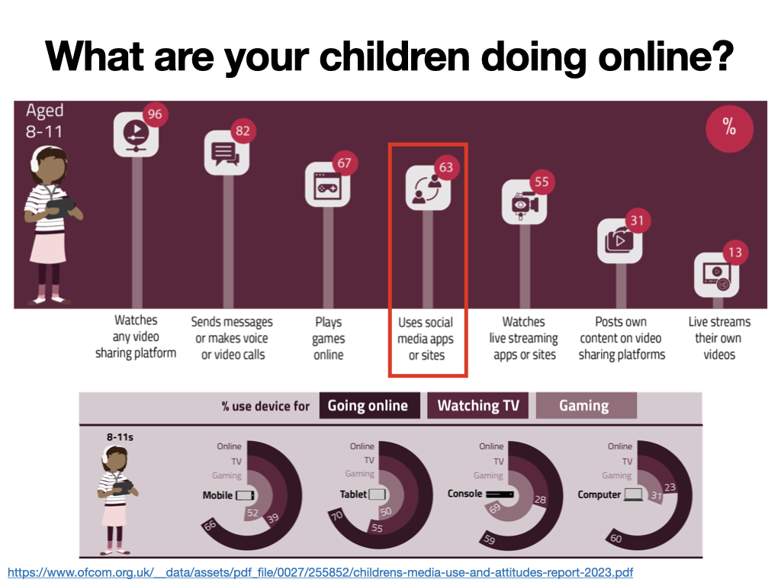
https://www.ofcom.org.uk/__data/assets/pdf_file/0027/255852/childrens-media-use-and-attitudes-report-2023.pdf
Notes:
8 - 11s - In this age range, 67% play games online which has almost doubled from the 5-7s. What are the risks of playing online? Who are the children playing with? Who are they talking to when they are playing online? Have they spent any money? The average 8-17 year old spends £38 per month on in-app purchases in games.
This age range also sees a rise in the number of children on social media apps. A quarter of those children using social media apps reported pressure to be popular on social media ‘all or most of the time’ while two-fifths of users believed that people were unkind to others on social media ‘all or most of the time'. The data also shows that a third of children in this age range have seen something worrying or nasty.
Have any of your children spoken to you about something they had seen online that was either worrying or nasty? Share any examples. We need to make sure children are aware they can speak to us about anything they see online.

Slide 15
https://www.ofcom.org.uk/__data/assets/pdf_file/0027/255852/childrens-media-use-and-attitudes-report-2023.pdf
Notes:
Tablets and mobile phones are the most popular devices within these age ranges. Tablets are generally used by younger children with the ownership of mobile phones rising rapidly at around age 8-11 as children become more independent.
An interesting statistic to come from the Ofcom report is that while watching TV was still a popular activity, many children will often be using other devices while the television is on in the background.

Slide 17
https://www.bbc.com/mediacentre/2023/ai-week
https://www.internetmatters.org/tech-and-kids-digital-futures/using-artificial-intelligence-safely/
https://www.bbc.co.uk/news/resources/idt-74697280-e684-43c5-a782-29e9d11fecf3
https://www.unicef.org/innovation/sites/unicef.org.innovation/files/2018-11/Children and AI_Short Verson (3).pdf
https://www.bbc.co.uk/newsround/64801896
Notes:
These articles provide lots of talking points about the positives and negatives of technology and the influence it will have on children’s lives in years to come, emphasising how important it is to make sure children have a good understanding of the technology they use.

Slide 18
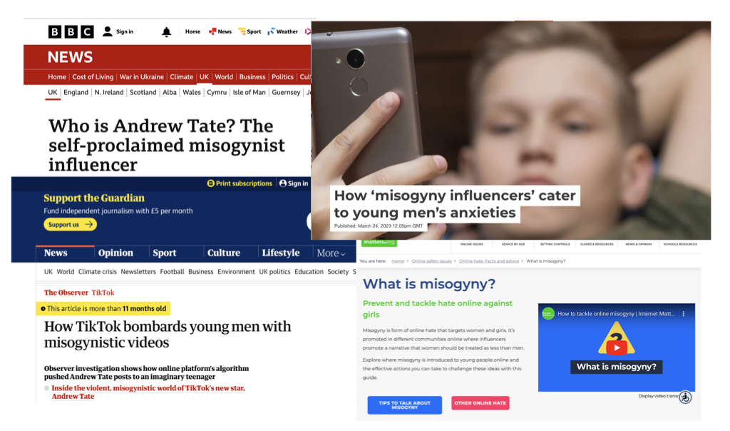
https://theconversation.com/how-misogyny-influencers-cater-to-young-mens-anxieties-201498#:~:text=
https://www.theguardian.com/technology/2022/aug/06/revealed-how-tiktok-bombards-young-men-with-misogynistic-videos-andrew-tate?CMP=Share_iOSApp_Other
https://www.internetmatters.org/issues/online-hate/what-is-misogyny/
https://www.bbc.co.uk/news/uk-64125045
Notes:
The articles on misogynistic influences (most notably Andrew Tate) are good examples of making sure we are all aware of the content children are consuming online as this type of harmful content can easily sneak into various social media algorithms and become a negative influence on children (not just boys).

Slide 19
Notes:
Discussion point. Share answers, highlight the positives. There is no correct answer to this question. Every parent and child is different, and it will be what works for your particular relationship and circumstances.

Slide 20
https://www.internetmatters.org/resources/online-gaming-advice/online-gaming-the-benefits/
Notes:
As parents and carers we need to acknowledge there is a positive side to our children’s online lives, we need to make sure that we don’t just focus on the negatives otherwise our children won’t talk to us about concerns they have. At the point you allow your children to access online gaming, video sharing platforms or social media you need to talk to them about the benefits as well as the risks. This conversation may start with by regularly asking what it is they like about the app or game they are using.

Slide 21
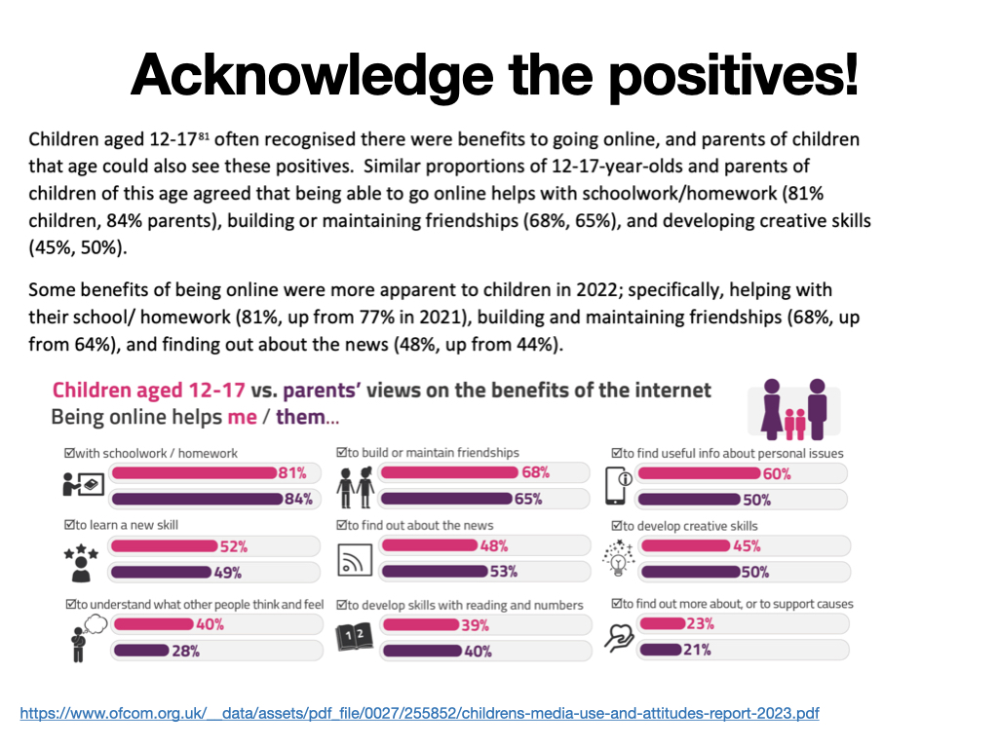
https://www.ofcom.org.uk/__data/assets/pdf_file/0027/255852/childrens-media-use-and-attitudes-report-2023.pdf

Slide 22
Notes:
We need to develop empathy with our children and understand that our children grow up in a different world to the one we did. There is greater peer pressure for children to have an online presence whether it is playing games, creating and sharing videos or commenting on social media. We need to understand this and listen to our children about their online experiences otherwise we will never understand the world our children are growing up in.

Slide 23
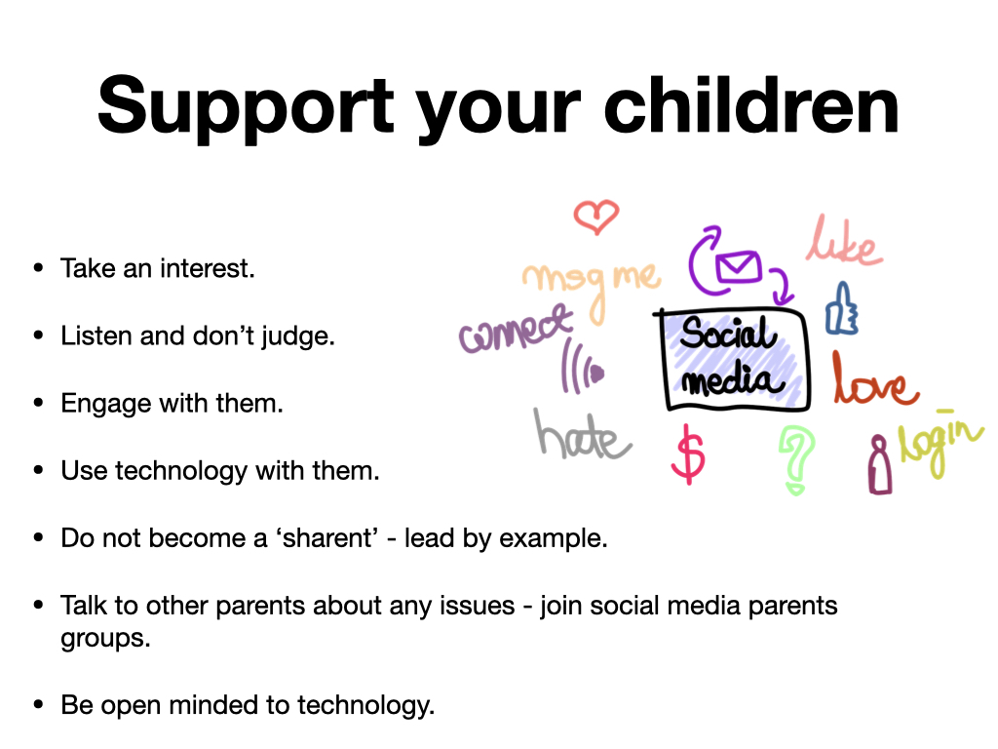
Notes:
Take an interest - you may not have heard of some of the apps/ games the children are playing or using but talk to them and ask them to show you how to play the games or use the apps they are interested in. As a parent, you will look at things differently to your child and you can deal with any concerns you may have with them.
Engage with them - regular communication about technology with your children will mean children are more likely to talk to you if they have an issue online as they believe you are interested and able to help them.
Use technology with them - include them in your use of technology. Ask them for permission if you are sharing pictures of them, this will teach a positive habit. Take the lead and show them how YouTube works, show them how you write emails, post to your social media and make sure your profiles are positive, so they copy your lead.
Do not become a ‘sharent’ - we know that children copy adult behaviours so we have a responsibility to be a role model when using our own social media and the amount of time children see you accessing technology. We need to teach good habits and it may be that if a parent wants to share an image, then they ask their child’s permission, this teaches them a positive behaviour and they may ask others before sharing images.

Slide 24
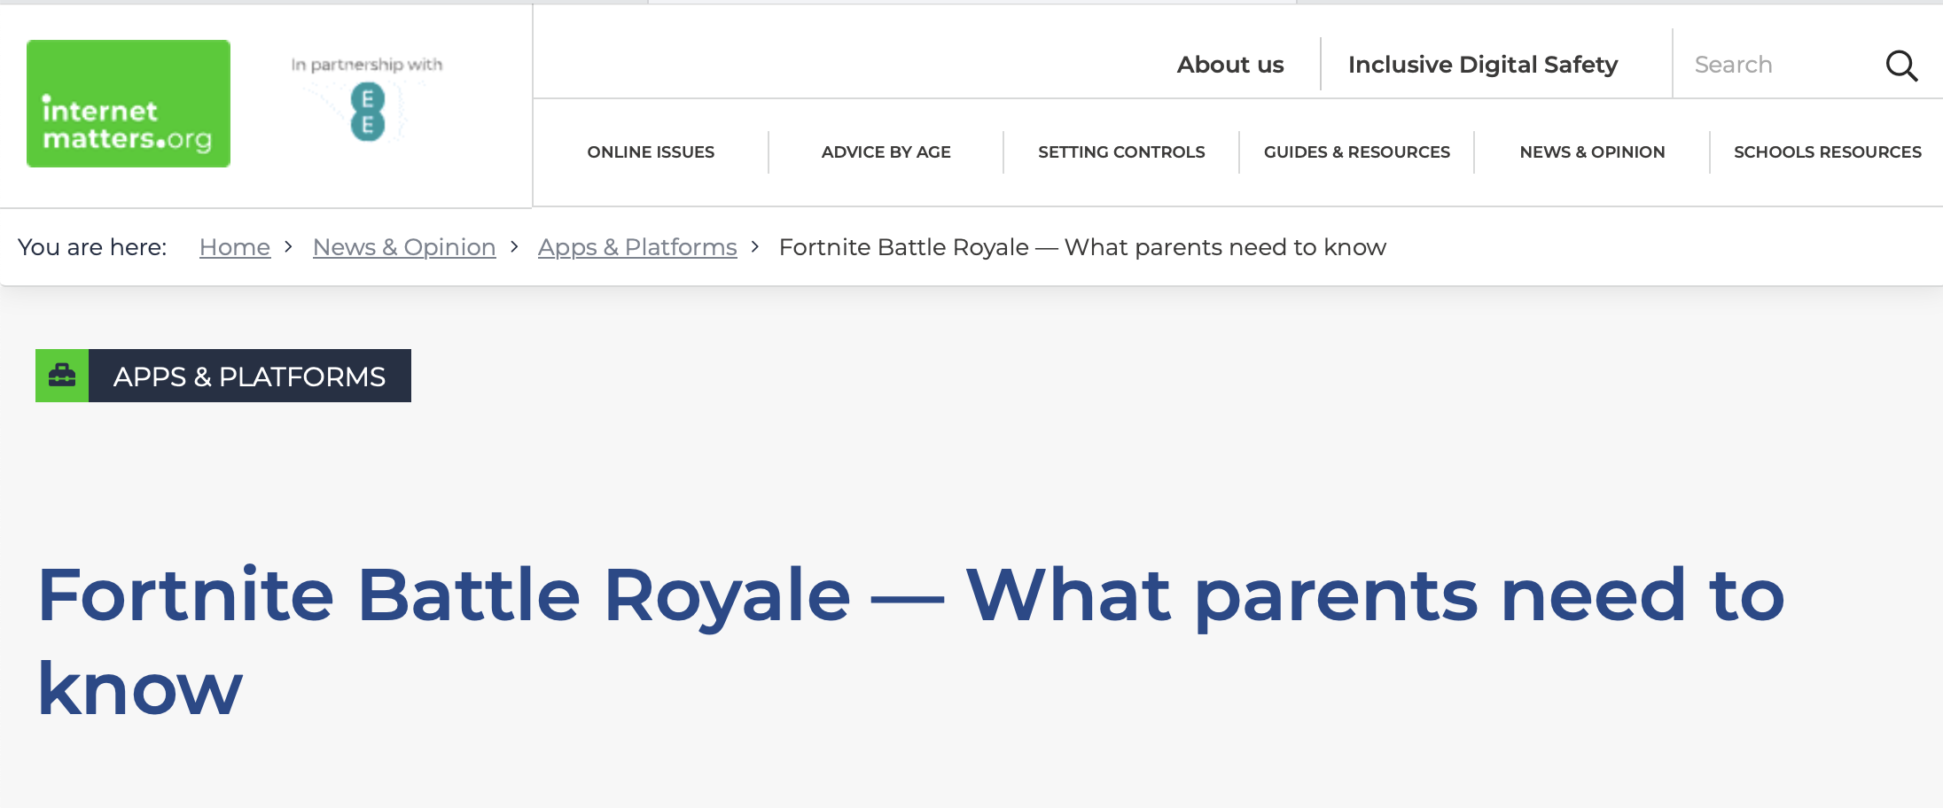
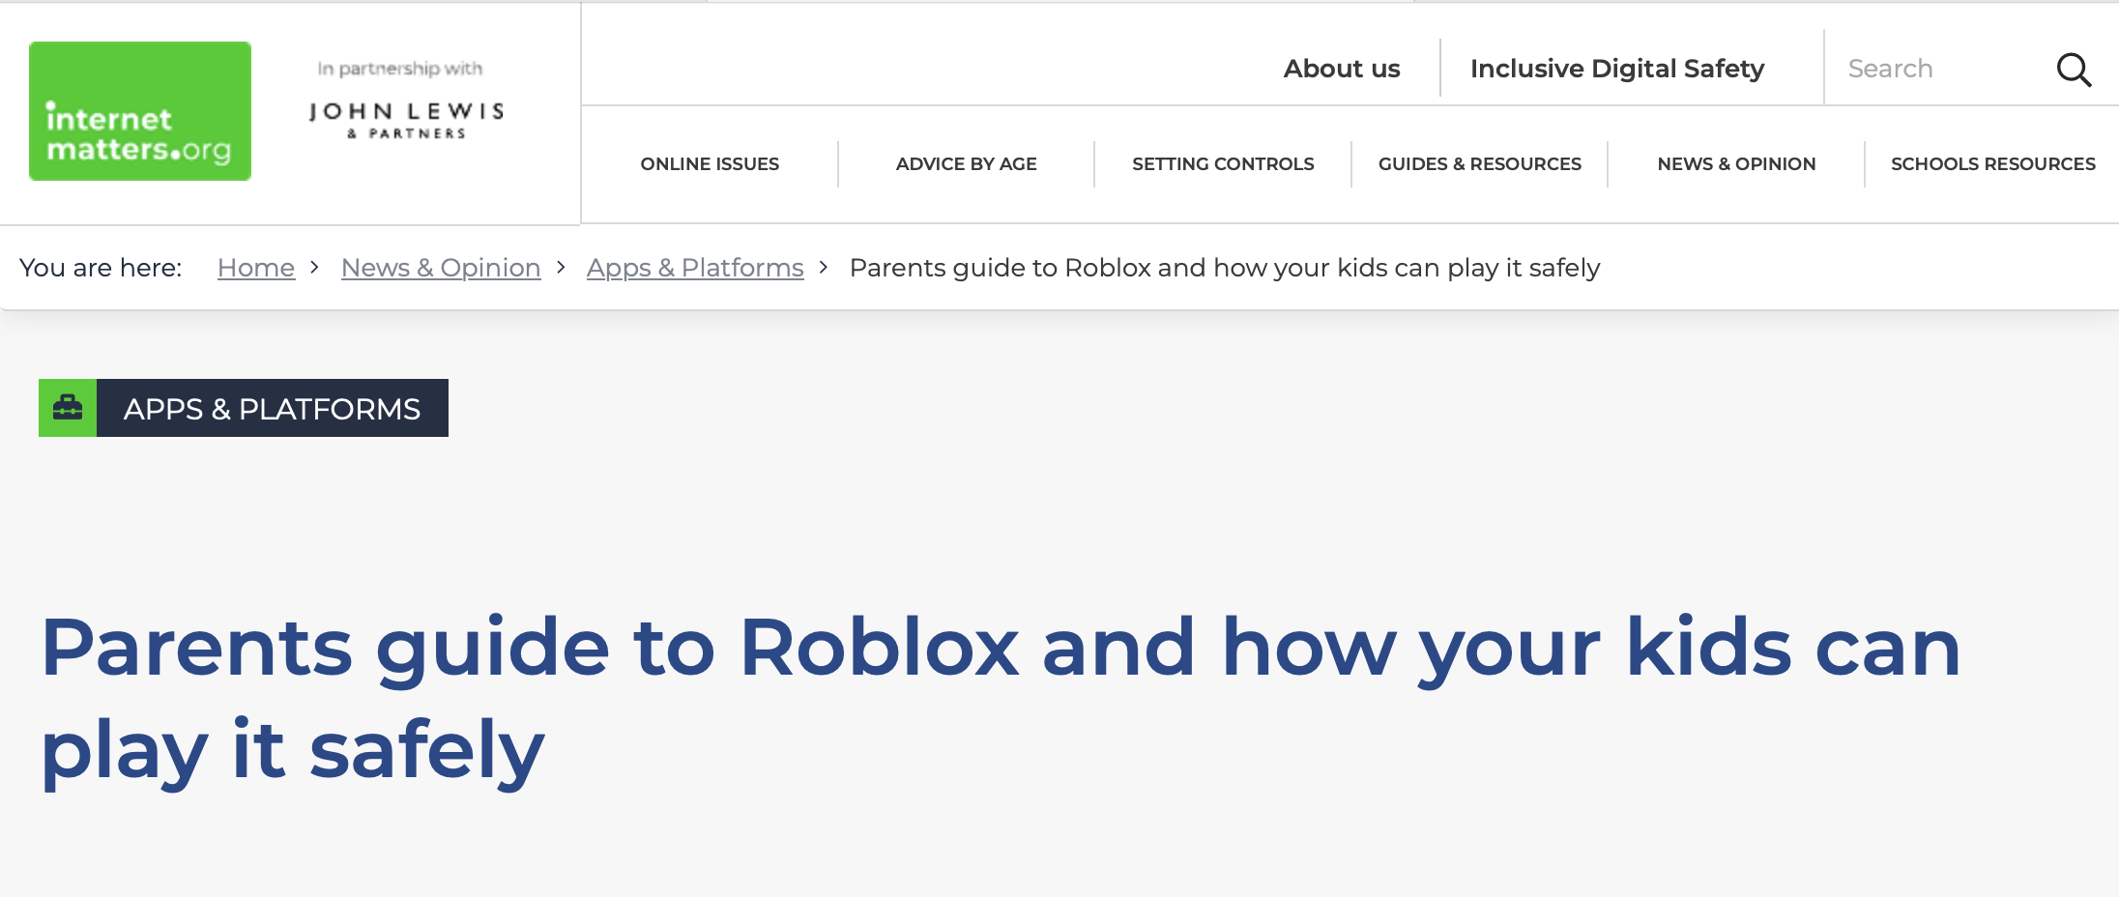
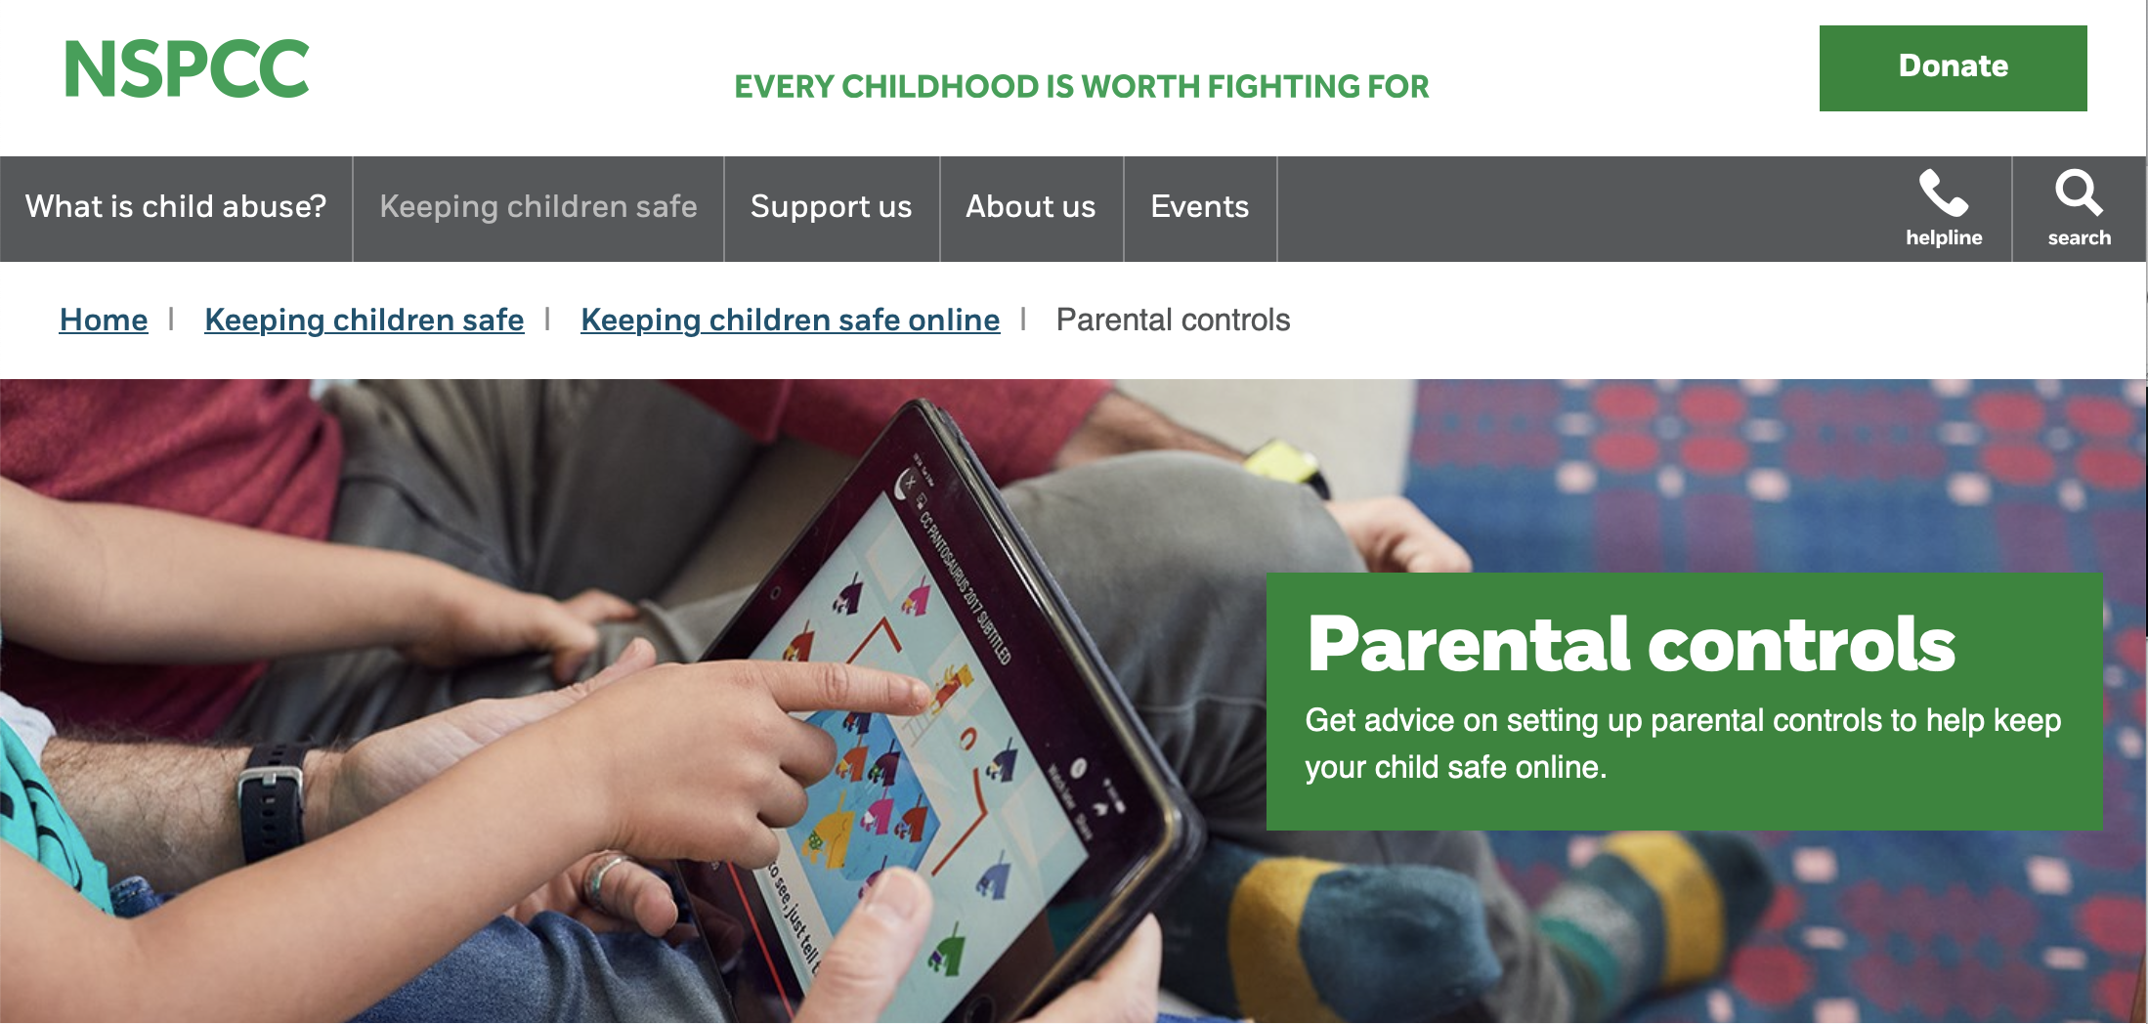
Be Knowledgeable
https://www.internetmatters.org/
https://www.nspcc.org.uk/keeping-children-safe/online-safety
Notes:
While it is impossible to stay up to date with every new app, game or social media trend that children may want to take part in, staying knowledgeable about the digital landscape children inhabit can help you to connect with your children about their interests and provide advice on how to stay safe online. The two websites on this slide are regularly updated with new information and articles to help parents and carers stay up to date with online trends. We also share the monthly parent online safety newsletter.

Slide 25
Notes:
We need to acknowledge, that within the huge landscape that is the internet, our children will make mistakes which can be used as learning opportunities. If children do make mistakes, then they should feel they can talk to us (trusted adults) about them. The slide shows that our children are less likely to talk to their parents/carers than those in other countries as they are concerned about the response they may receive. We can avoid this by being upfront with our children and reassure them that they will not be punished for the mistakes they make online if they talk to us about them.

Slide 26
https://www.taminggaming.com/home
Notes:
This is a brilliant site for supporting parents to make informed choices about which games to allow their children to play. For any game a parent is unsure about, you can simply type the name of it into the Taming Gaming site and it will give you the PEGI rating and some of the risks associated with it. As good as this site is, we would always recommend parents checking the site and then sitting with their child while they played a specific game.

Slide 27
http://testfiltering.com/
Notes:
Home filtering is freely available within home broadband. Run this test on devices at home to minimise the risk of children seeing inappropriate content.

Slide 28
Notes:
There are many guides for applying parental controls on different apps and devices. We will email out a parental controls booklet following this session and continue to include any updates in our Online Safety newsletters.

Slide 31
https://www.internetmatters.org/parental-controls

Slide 32
Support for you
You can alway speak to:
CEOP
NSPCC
School
Or for more general information you can visit these sites:
UK Safer Internet Centre (https://www.saferinternet.org.uk/)
Internet Matters (https://www.internetmatters.org/)
The Parent Zone (https://parentzone.org.uk/home)

